Slide 1
Matched Field Source Localization as A Multiple Hypothesis Tracking Problem
Qiuyun Wu, Wen Xu
College of Information Science & Electronic Engineering, Zhejiang University
WUWNet’17 November 8, 2017, Halifax, Canada
Notes:
Good morning, everyone. I’m Shougui cai, from Zhejiang university, China. As Qiuyun Wu was not able to come here, I’ll do this presentation. The topic I’m talking about today is “Matched Field Source Localization as A Multiple Hypothesis Tracking Problem”.

Slide 2
Introduction
Our Goal
Propose an method to locate an underwater target in low SNR scenarios.
Conventional method
Matched-field processing (MFP). It is a common technique for point source location problems in an acoustic waveguide.
However, MFP shows poor performance when SNR is low or environmental parameters are not accurate.
Notes:
First, let’s talk about why we process an source localization problem as a Multiple Hypothesis Tracking Problem.
To locate an underwater target, we usually use matched-field processing. However, it performs badly when SNR is low or environmental parameters are not accurate.

Slide 3
Introduction
What will happen in low SNR scenarios when we use MFP to locate a target?
Notes:
Before we talk about how to locate a target in an acoustic waveguide in low SNR scenarios, I want to show you what will happen in low SNR scenarios when we use MFP to locate a target?
Here is an example. The target is moving alone the white line. Red block means the position of the target, green block means MFP locating result, and black crosses mean Highest 15 peaks in the ambiguity plane.
It’s easy to find that the position of the highest peak in the ambiguity plane might be far from the true source position while the position of other peaks might be quite close to the target.
This remind us that, in low SNR scenarios, by choosing more peaks from the ambiguity plane, we can get one peak near the true target more easily than when we only pick the highest peak.

Slide 4
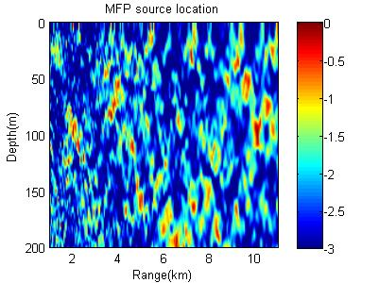
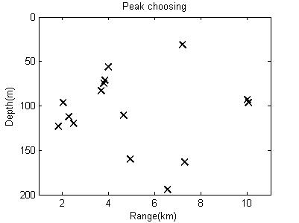
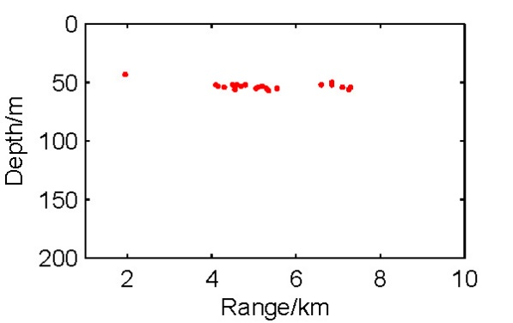
Method
Measured
Field
MFP
For each scan of data, use MFP to get the ambiguity plane and choose the highest peaks.
Ambiguity
Plane
Peak
Choosing
Position of
Peaks
Use MHT to track the target.
MHT
Trajectory
Notes:
Therefore, we proposed a method as shown in the block diagram.
First, to locate the target at a specific time, we use processed measured field data and Conventional MFP to generate the ambiguity plane. Usually we choose the position of the maximum point in the ambiguity plane as the locating result. However, as we’ve talked about before, in low SNR circumstance, the result is not reliable.
So we choose maybe 10 or 20 highest peaks in the ambiguity to increase the “detection probability” of the true target at the cost of introducing some false targets. I define “Detection probability” here as the Probability of finding one peak near the true target.
And when the target is moving, we get serval scans of data, each of them contains the position of the peaks chosen before. We can use these range and depth data and the MHT algorithm to track the true target with the assumption that the false ones are not relative from scan to scan. MHT is an algorithm usually used to track single/multiple target in the presence of detection uncertainty and clutter by forming and propagating alternative association hypotheses of measurements and tracks, with the expectation that the future measurements will solve assignment ambiguities. We use MHT here to remove those peaks that are not relevant to the true target. With the help of MHT, we can get a better result than conventional MFP does.

Slide 5
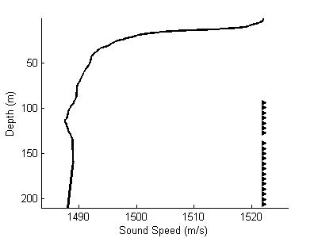
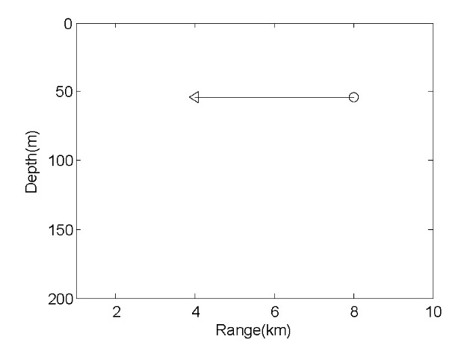
Simulation
Environment and true target trajectory
MFP:
Bartlett processor. The sample-covariance matrix (SCM) is averaged over every 28 snapshots of acoustic field data whose SNR at VLA is -14 dB.
Peak choosing:
The input of MHT is the highest 10 peaks from the ambiguity plane of each scan.
(4km, 54m)
(8km, 54m)
Notes:
Then comes to the simulation part.
The environmental parameters used here is from SWellEx-96 with 21-element vertical linear array (VLA) as well as sound speed profile (SSP) from station 5. The SSP and the depth of each element in the VLA is shown in the left figure.
And we have a moving target moving from (8km, 54m) towards (4km, 54m). It moves 100m every discrete time increment. The trajectory of the target is shown in the right figure.
We use Bartlett processor to process the data, in which the SCM is averaged over every 28 snapshots of acoustic field data and the SNR at VLA is -14dB.
We use an easy peak choosing strategy by choosing the highest 10 peaks from the ambiguity plane for each scan of data in this simulation.

Slide 6
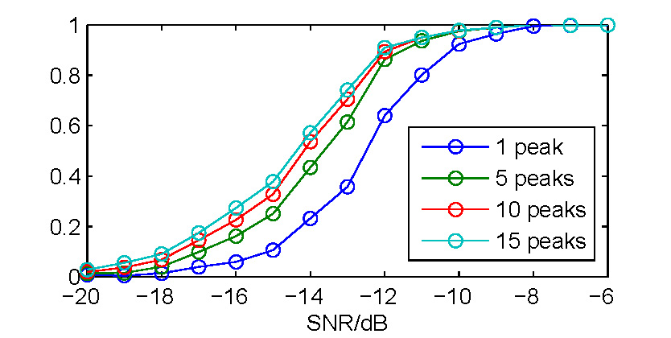
Simulation Results
Peak numbers and “Detection probability”
Notes:
Detection probability here means probability of finding a peak near the true target.
It is shown in this figure that “Detection probability” grows as the number of peaks we choose increases.
We do this simulation to verify our assumption that by choosing several peaks in the ambiguity plane, we can get a position measurement near the true target easier.

Slide 7
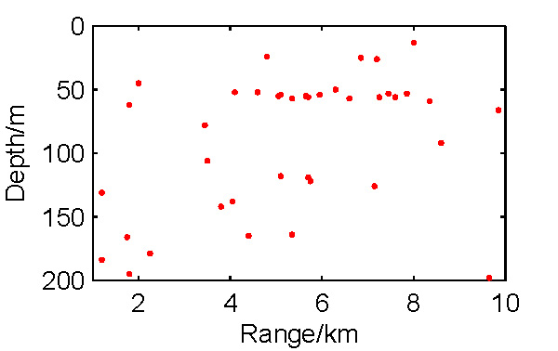

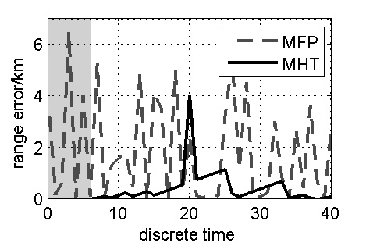
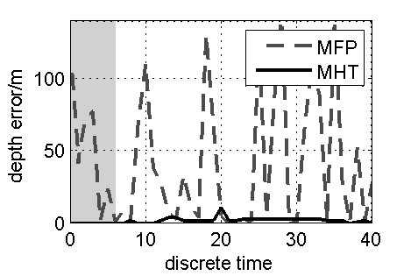
Simulation Results
Locating and Tracking Results:
Range and Depth Error
MFP locating result
MHT tracking result
Notes:
The MFP locating result is shown in the upper left figure, in which we just choose the highest peak.
The tracking result using MHT is shown in the upper right figure, in which we choose the position of 10 peaks from the ambiguity plane in every processing scan as the input of an MHT tracker.
The figures below compare the range and depth errors between these two methods. The dashed line and the solid line represent the range and depth errors of MFP and MHT respectively. In the shadowed intervals, MHT tracker lost the target. Sometimes MHT tracker will output more than one target, we choose the worst case to plot the lower two figures, in which the worst case means choosing the target with maximal range and depth error as its output.
With the method presented here, the locating result will be more reliable than the conventional MFP in low SNR environment.

Slide 8
Conclusion
The simulation results show that with the method proposed in this paper, we can make full use of the highest peaks in MFP ambiguity plane and MHT algorithm to get a tracking result with a distinct trajectory as well as lower range and depth error than conventional MFP in low SNR scenarios.
Further work might be done on this framework to enhance the tracking performance when environmental parameters are not accurate.
Notes:
The simulation results show that with the method proposed in this paper, we can make full use of the highest peaks in MFP ambiguity plane and MHT algorithm to get a tracking result with a distinct trajectory as well as lower range and depth error than conventional MFP in low SNR scenarios.
Further work might be done on this framework to enhance the tracking performance when environmental parameters are not accurate.

